Slide 1


Julia - A Modern Platform for Statistical Computing & Data Science
Date 14th Feb, 2026
Sujit Sandipan Chaugule
B. Tech in Pharmaceutical Sciences & Technology
Personal Web Page: https://sites.google.com/view/statsphere

Slide 2
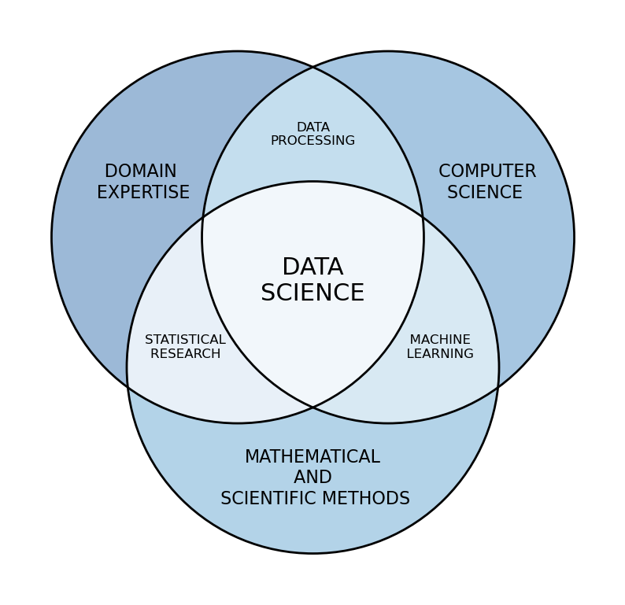
Foundations of Statistical Computing & Data Science
Statistical computing and data science are foundational to modern scientific inquiry and evidence-based decision-making.
Rapid growth in data volume, variety, and complexity across domains such as ecology, biology, engineering, economics, and social sciences has made computational approaches indispensable.
Statistical computing provides the bridge between statistical theory and real-world applications through efficient algorithms, numerical methods, simulation, and data visualisation.
Data science integrates statistics, computer science, and domain knowledge to transform raw data into meaningful and actionable insights.
Source: Data science - Data Cymru

Slide 3
Role of Statistical Computing in Modern Analysis.
Statistical computing enables the practical implementation of statistical models for large and complex datasets that cannot be handled manually.
It combines statistical reasoning with algorithms, data structures, and efficient computing techniques from computer science.
Key capabilities include simulation-based inference, probabilistic modelling, optimization, uncertainty quantification, and performance evaluation.
It plays a central role in engineering systems, machine learning, and artificial intelligence by supporting predictive modelling and learning under uncertainty.

Slide 4
Impact of Data Science Across Domains
In healthcare, data science supports disease prediction, personalized medicine, medical imaging analysis, and drug discovery.
In engineering and manufacturing, data-driven approaches enable smart systems, predictive maintenance, digital twins, and real-time optimization.
Financial, business, and environmental sectors rely on data science for risk management, forecasting, fraud detection, and climate modeling.
Together, statistical computing and data science form a unifying framework that drives innovation, efficiency, and informed decision-making in modern science and engineering.

Slide 5




Limitations of Traditional Workflows in Statistical Computing & Data Science
Statistical models use compact mathematical notation, but implementation in R, Python, or MATLAB is verbose and library-dependent, obscuring assumptions and increasing coding errors.
Interpreted execution and reliance on external optimized libraries introduce overhead from language boundaries and memory copying, limiting scalability for large simulations and Monte Carlo methods.
Exploratory analysis and production computation are often disconnected, requiring substantial code restructuring and reducing efficiency and reproducibility.
These limitations motivate Julia as a unified platform combining mathematically expressive modeling with high-performance execution for modern statistical computing and data science.

Slide 6
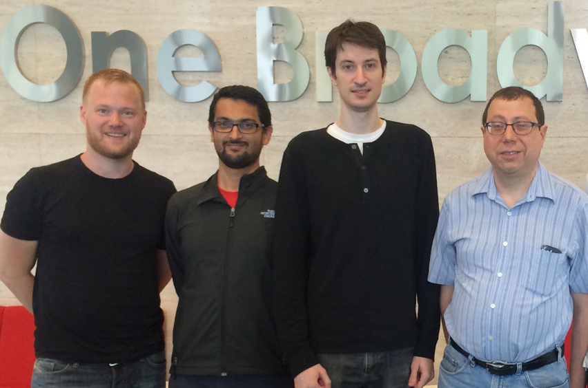
Julia: A New Platform
Julia is an open-source, high-performance programming language introduced in 2012 by Stefan Karpinski, Viral B. Shah, Jeff Bezanson and Alan Edelman.
It combines the interactive syntax of languages such as Python, MATLAB, and R with the speed of compiled languages like C, C++, and Fortran.
Julia was designed for computationally intensive scientific and technical computing, balancing ease of use with execution efficiency.
The language bridges productivity-oriented and performance-oriented programming paradigms, making it accessible to users from diverse technical computing backgrounds.

Slide 7
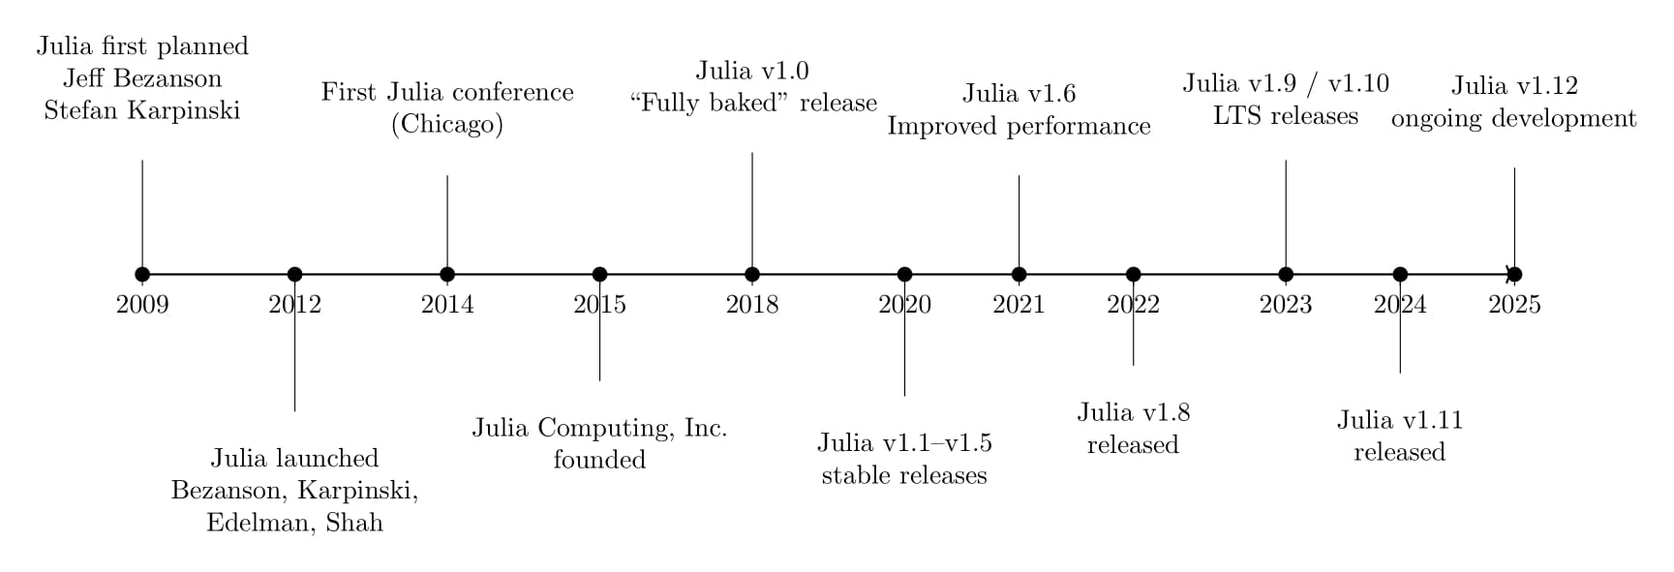
Julia: A New Platform
A timeline illustrating the origin and step-by-step evolution of the Julia programming language

Slide 8
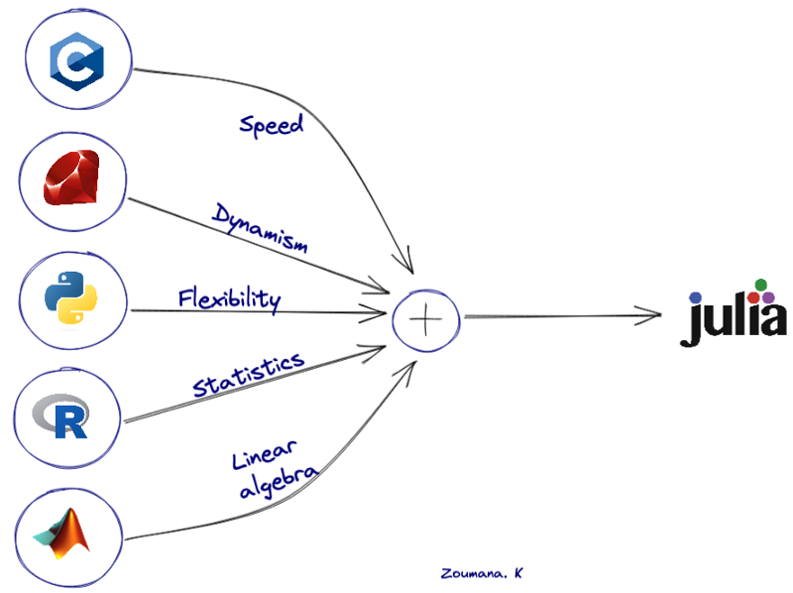
Julia: A New Platform
High-performance dynamic language with a just-in-time (JIT) compiler, delivering speeds comparable to statically compiled languages like C and Fortran.
Supports distributed parallel execution, precise numerical computations, and a comprehensive library of mathematical functions for scientific applications.
Designed to overcome limitations of R, Python, and MATLAB in handling large datasets and complex computations efficiently.
Extensive package ecosystem via Integrated Package Management (IPM), suitable for scientific computing, data analysis, machine learning, and scalable technical applications.
Source: Introduction to Julia with a comparison to Python and R

Slide 9
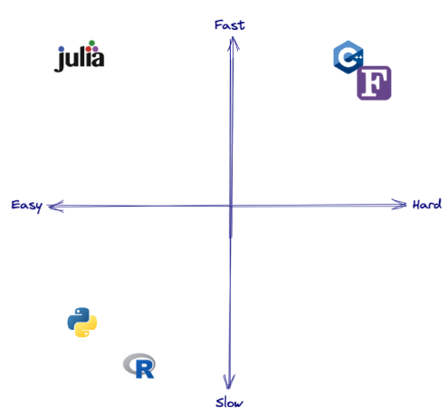
Julia: A New Platform
Julia provides a straightforward and expressive syntax, making it easy to learn for users familiar with MATLAB, R, or Python.
Multiple dispatch allows functions to be specialized based on argument types, enabling high-performance generic programming and easy extension of existing functions.
Julia can directly call C, Fortran, and Python libraries, and package management via IPM simplifies access to community-developed tools.
Julia combines the productivity of high-level dynamic languages with the execution speed of compiled languages, addressing the two-language problem.
Built-in support for parallel and distributed computing allows efficient execution across multiple cores or machines, suitable for scientific computing and machine learning.
Source: Introduction to Julia with a comparison to Python and R

Slide 10
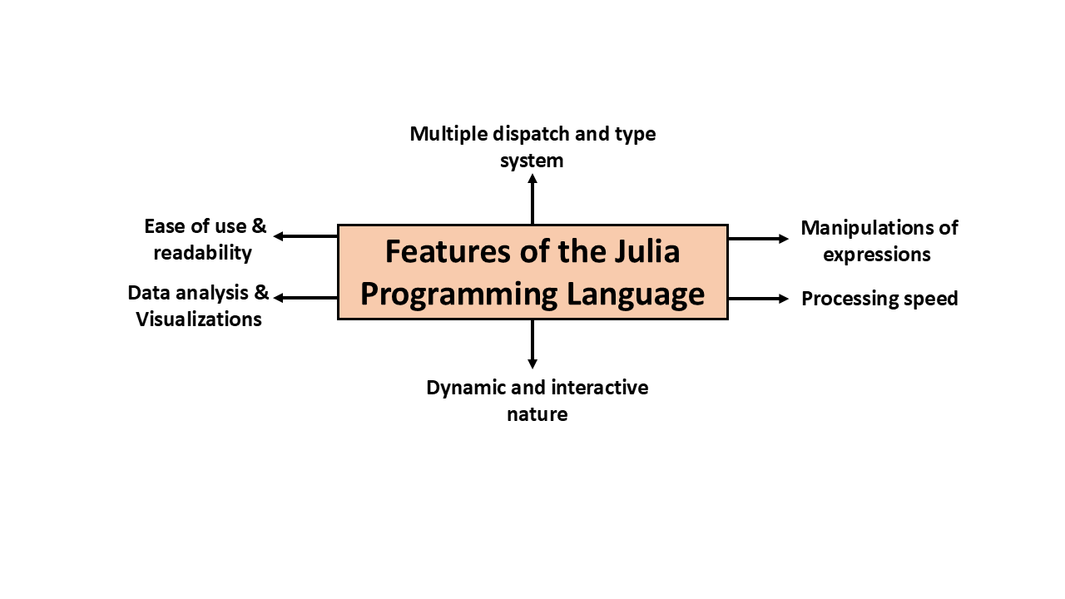
Some Important Features of Julia
Julia provides a dynamic and interactive programming environment, allowing rapid experimentation and development without rewriting large portions of code.
Its high execution speed approaches that of compiled languages like C/C++, making it ideal for large-scale data processing and complex computations.
Julia supports parallel and distributed computing, reducing computation time on big datasets and improving scalability for statistical and machine learning workflows.
Metaprogramming allows programs to construct and manipulate expressions as first-class values, addressing the two-language and expression problems in scientific computing.

Slide 11
Some Important Features of Julia
Julia’s simple syntax and high-level abstractions make model development, statistical analysis, and data workflows accessible to Python, R, or MATLAB users.
Multiple dispatch and a robust type system enable expressive, modular, and reusable code while maintaining high performance across diverse implementations.
Data analysis and visualization are highly efficient; MATLAB and Octave code can be reused via MatlabCompat.jl, while RCall.jl and PyCall.jl allow seamless R/Python integration.
Julia unifies productivity and performance in a single language, eliminating the need to switch between high-level and low-level languages.

Slide 12
Mathematical Equations to R or Python Code: Lost in Translation
Loss of meaning in translation: When mathematical equations are converted to R or Python code, the core idea can get obscured, making it hard to connect the code back to the theory.
Reduced transparency: This disconnect lowers clarity within an organization or team, as not everyone can easily trace how the math is implemented in the code.
Communication gap: Even fellow data scientists may struggle to fully understand the approach or logic behind the code if the mathematical intent isn’t clear.
Lack of explainability in AI/ML: This gap widens further in machine learning and AI, where models are already complex, leading to reduced interpretability.

Slide 13
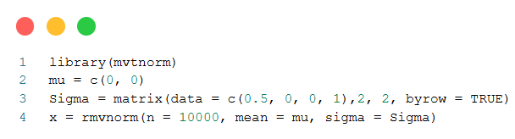
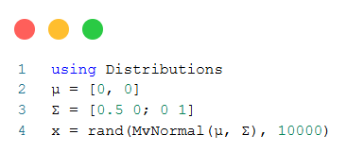
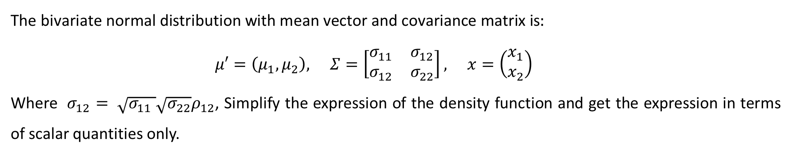
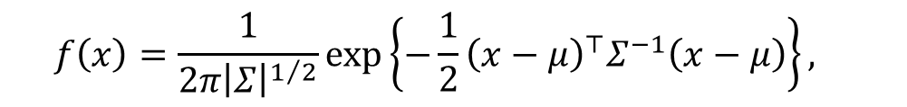
Mathematical Equations to R or Python Code: Lost in Translation
Here consider the example of a bivariate normal PDF
$$f\left(x\right)=\frac{1}{2π{\left|Σ\right|}^{1/2}}exp\left\{−\frac{1}{2}{\left(x−μ\right)}^{⊤}Σ^{−1}\left(x−μ\right)\right\},$$
$$\text{The} \text{bivariate} \text{normal} \text{distribution} \text{with} \text{mean} \text{vector} \text{and} \text{covariance} \text{matrix} \text{is}:$$
$μ′=\left(μ_{1},μ_{2}\right), Σ=\left[\begin{matrix}σ_{11} & σ_{12} \\ σ_{12} & σ_{22}\end{matrix}\right], x=\left(\begin{matrix}x_{1} \\ x_{2}\end{matrix}\right)$
Where $σ_{12}= \sqrt{σ_{11} }\sqrt{σ_{22}}ρ_{12}$, Simplify the expression of the density function and get the expression in terms of scalar quantities only.
R Code:
Julia Code:

Slide 14
Julia's deep learning, machine learning, and statistical computing ecosystem
An overview of Julia’s ecosystem for deep learning, machine learning, and statistical computing is presented, highlighting community-driven packages for data manipulation, statistical modelling, scientific machine learning, and visualization. The following table provides a concise summary of major Julia communities, representative packages, and their primary application areas relevant to statistical computing and data science.
Sr. No. | Community | Representative Packages | Primary Applications
1 | JuliaStats | StatsBase.jl, MultivariateStats.jl, HypothesisTests.jl | Statistical modeling, inference, and machine learning
2 | JuliaImages | ImageTransformations.jl, Images.jl, ImageSegmentation.jl | Image analysis and image processing
3 | SciML | DifferentialEquations.jl, ModelingToolkit.jl | Scientific machine learning and mathematical modeling
4 | JuliaData | DataFrames.jl, DataFramesMeta.jl | Data manipulation, storage, and input–output operations
5 | FluxML | Flux.jl, MacroTools.jl, GeometricFlux.jl | Machine learning and deep learning
6 | JuliaPlots | StatsPlots.jl, Plots.jl ,PlotlyJS.jl | Data visualization and graphical analysis

Slide 15
Julia's deep learning, machine learning, and statistical computing ecosystem
Statistical Computing: Julia provides a unified, high-performance environment for data handling, statistical modelling, and visualization through the JuliaStats and JuliaData ecosystems. Core packages such as StatsBase.jl, HypothesisTests.jl, MultivariateStats.jl, DataFrames.jl, and StatsPlots.jl support descriptive statistics, inference, multivariate analysis, data wrangling, and exploratory visualization.
Machine Learning: Julia’s ML ecosystem is centred around MLJ, which offers a unified interface for model training, tuning, evaluation, and comparison. Leveraging multiple dispatch and type specialization, Julia enables flexible yet efficient ML workflows and supports cross-language integration via tools like JuliaConnectoR.
Deep Learning: Native frameworks such as Flux.jl and Lux.jl enable expressive, high-performance neural network modelling with automatic differentiation and GPU support. Extensions like DiffEqFlux.jl, GraphNeuralNetworks.jl, and GeometricFlux.jl integrate deep learning with scientific computing, differential equations, and graph-structured data.

Slide 16

Notable Uses of Julia
Company
Organizations
Universities/ Institutes
Amazon
Apple
Capital One
Google
IBM
Intel
Pfizer
JPMorgan
Microsoft
NASA
US Fed Reserve
MIT
Stanford
TAMU
ETH Zurich
CMU
CMI

Slide 17
IDEs/Environments for Julia
VS Code + Julia extension
Pluto.jl (reactive notebook)
Jupyter (via IJulia)
Google Colab

Slide 18



Installation of Packages in Julia
Julia provides a built-in package manager, Pkg, to install and manage external libraries that extend the language’s capabilities. It allows users to easily install single or multiple packages, or even packages directly from GitHub repositories, ensuring flexibility and reproducibility in project environments.
Install a Single Package
Install multiple packages at once
Install a package from a GitHub URL

Slide 19
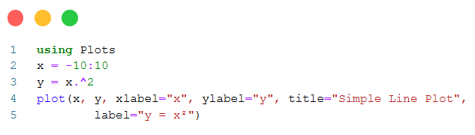
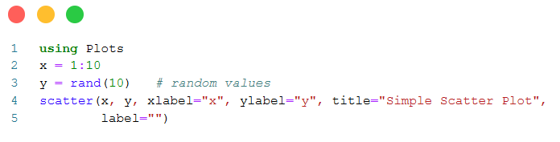
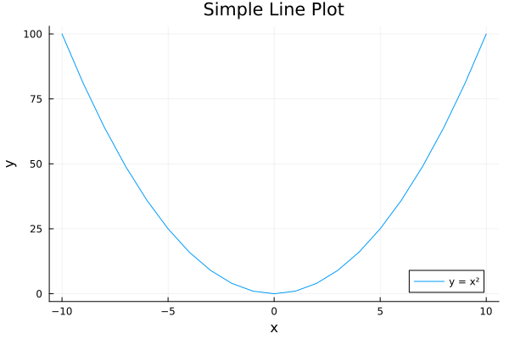
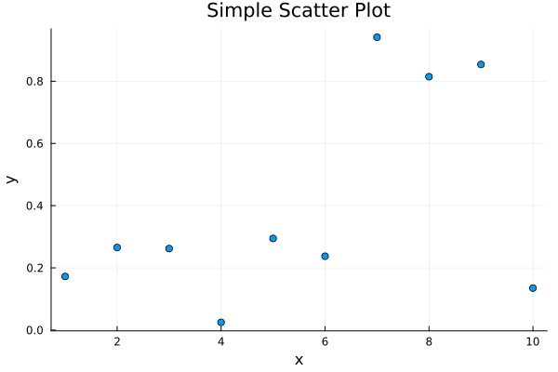
Basic Plotting in Julia
Julia provides powerful and flexible tools for data visualization through packages such as Plots.jl and Makie.jl. With simple and intuitive syntax, users can quickly create line plots, scatter plots, histograms, and more. Basic plotting helps in understanding data patterns, trends, and distributions effectively.

Slide 20
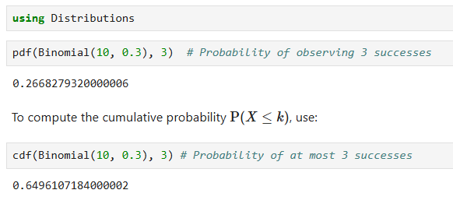
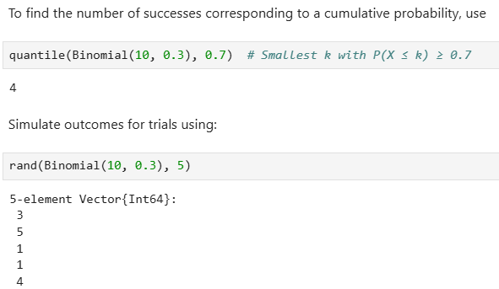
Probability Distributions in Julia
Binomial Distribution
The binomial distribution describes the probability of $k$ successes in n independent Bernoulli trials with success probability $p$. The PMF is:
$$P\left(X=k∣p\right)=\left({n \atop k}\right)p^{k}{\left(1−p\right)}^{n−k}, k=0,1,…,n; 0≤p≤1$$
For the example of an ecological study on a rare plant species, $n=10$ and $p=0.3$, representing the probability that a rare plant is found at a given location. The probability of observing exactly $k$ successes can be calculated as:

Slide 21
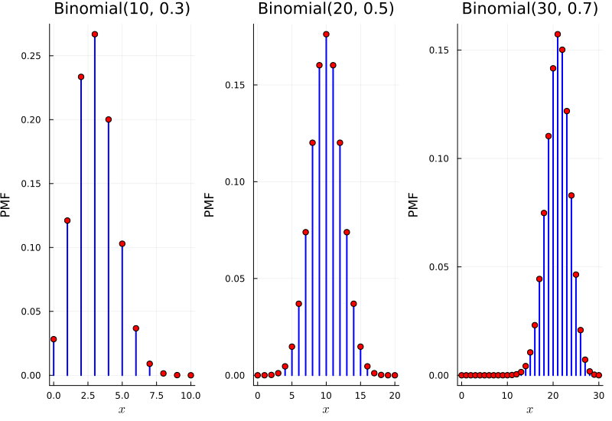
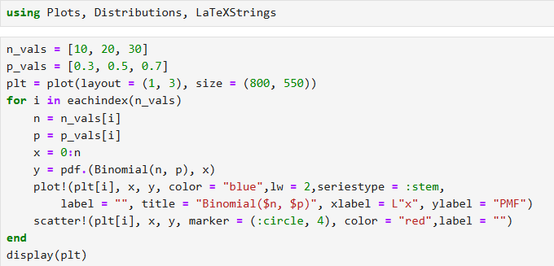
Probability Distributions in Julia
Binomial Distribution
To visualize how the binomial distribution behaves under different values of 𝑛 and 𝑝, we generate a plot and its PMF for three parameter combinations
𝑛 = 10, 𝑝 = 0.3,
𝑛 = 20, 𝑝 = 0.5,
𝑛 = 30, 𝑝 = 0.7.

Slide 22
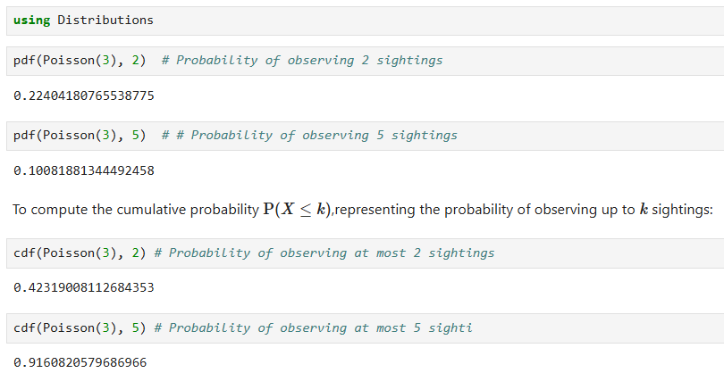
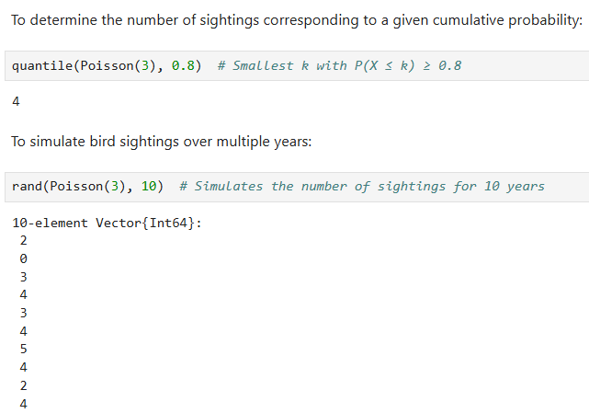
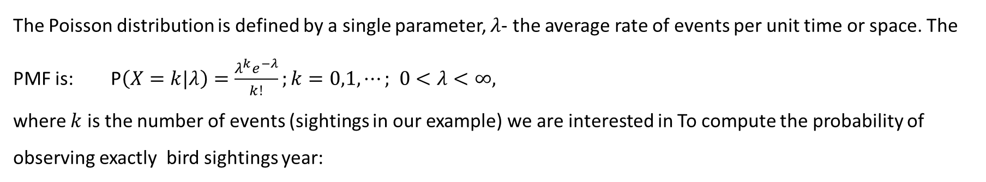
Probability Distributions in Julia
Poisson Distribution
The Poisson distribution is defined by a single parameter, $λ$- the average rate of events per unit time or space. The PMF is: $\text{P}\left(X=k|λ\right)=\frac{λ^{k}e^{−λ}}{k!};k=0,1,⋯; 0<λ<∞,$
where $k$ is the number of events (sightings in our example) we are interested in To compute the probability of observing exactly bird sightings year:

Slide 23
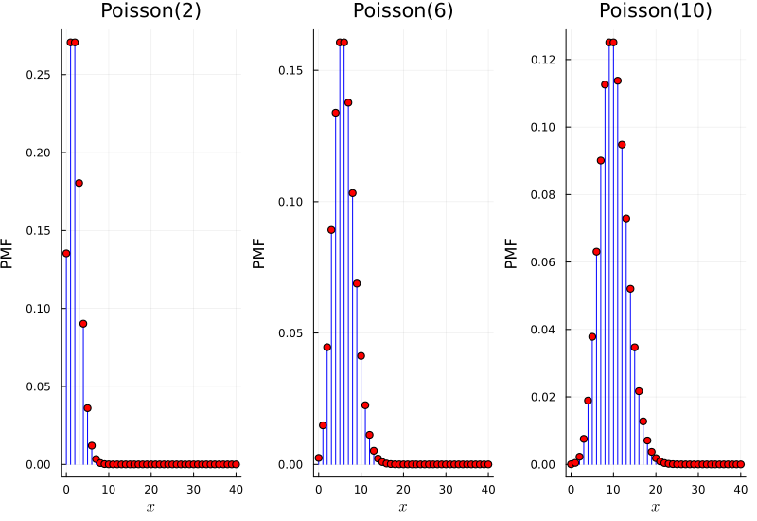
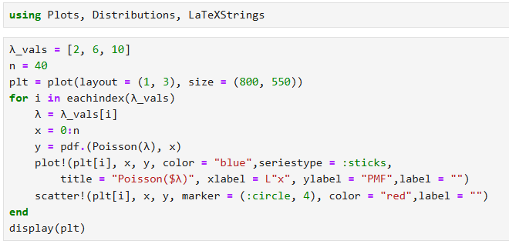
Probability Distributions in Julia
Poisson Distribution
The probability mass functions for various values of λ, highlighting the distribution’s tendency to become more symmetric as λ increases.

Slide 24
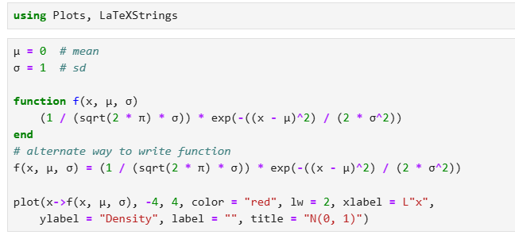
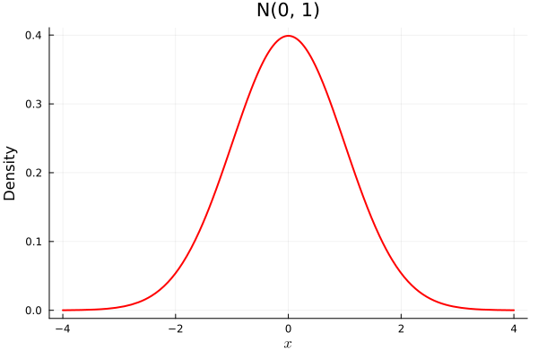
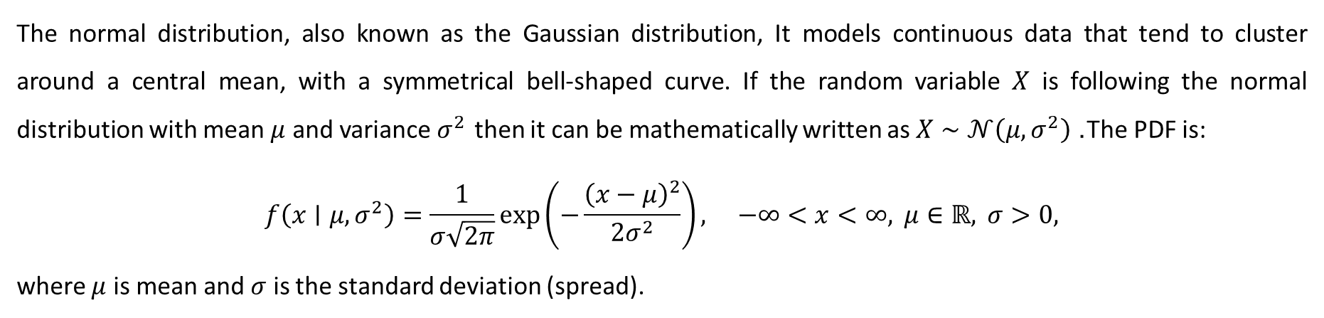
Probability Distributions in Julia
Normal Distribution
The normal distribution, also known as the Gaussian distribution, It models continuous data that tend to cluster around a central mean, with a symmetrical bell-shaped curve. If the random variable $X$ is following the normal distribution with mean $μ$ and variance $σ^{2}$ then it can be mathematically written as $X∼𝒩\left(μ,σ^{2}\right)$. The PDF is:
$$f\left(x∣μ,σ^{2}\right)=\frac{1}{σ\sqrt{2π}}exp\left(−\frac{{\left(x−μ\right)}^{2}}{2σ^{2}}\right), −∞<x<∞, μ∈ℝ, σ>0,$$
where $μ$ is mean and $σ$ is the standard deviation (spread).

Slide 25
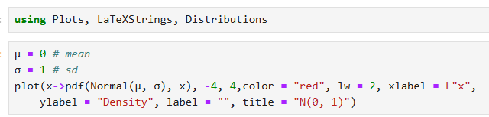
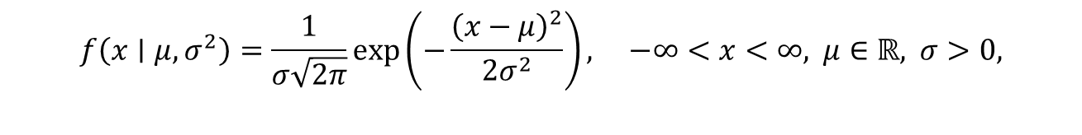
Probability Distributions in Julia
Normal Distribution
Also, we can use in-built function
$$f\left(x∣μ,σ^{2}\right)=\frac{1}{σ\sqrt{2π}}exp\left(−\frac{{\left(x−μ\right)}^{2}}{2σ^{2}}\right), −∞<x<∞, μ∈ℝ, σ>0,$$

Slide 26
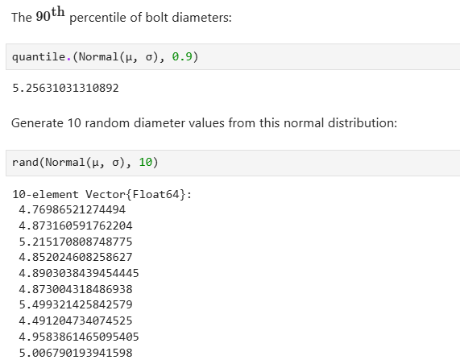
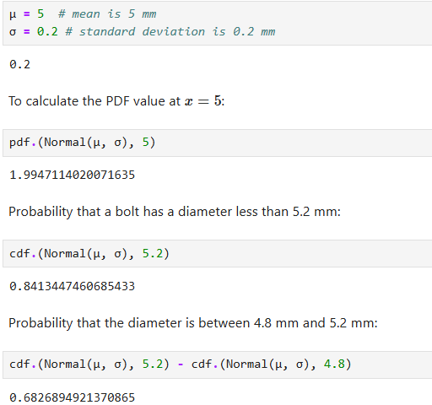
Probability Distributions in Julia
Normal Distribution
Example: Suppose the diameters of bolts manufactured by a machine follow a normal distribution with a mean of 5 mm and a standard deviation of 0.2 mm. A quality control analyst wants to calculate the probability that a randomly selected bolt has a diameter between 4.8 mm and 5.2 mm. Since the variation in diameters is due to random factors and most values are expected to be close to the mean, the normal distribution is appropriate for modelling this scenario.

Slide 27
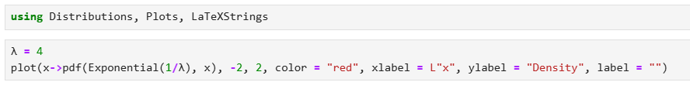
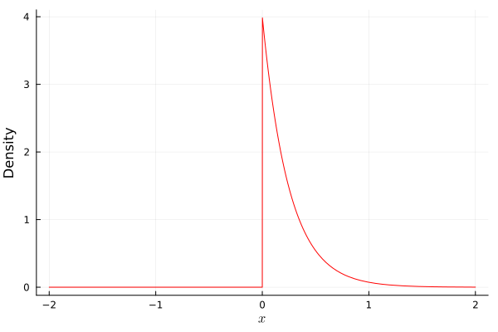
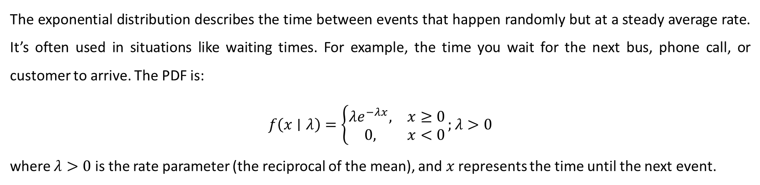
Probability Distributions in Julia
Exponential Distribution
The exponential distribution describes the time between events that happen randomly but at a steady average rate. It’s often used in situations like waiting times. For example, the time you wait for the next bus, phone call, or customer to arrive. The PDF is:
$$f\left(x∣λ\right)=\left\{\begin{matrix}λe^{−λx}, & x≥0 \\ 0, & x<0\end{matrix}\right.;λ>0$$
where $λ>0$ is the rate parameter (the reciprocal of the mean), and $x$ represents the time until the next event.
Rate parameter
Represents the time until the next event.

Slide 28
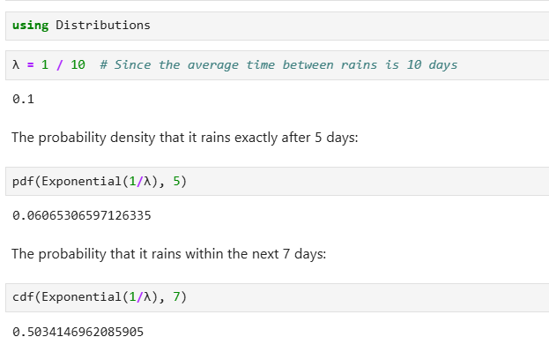
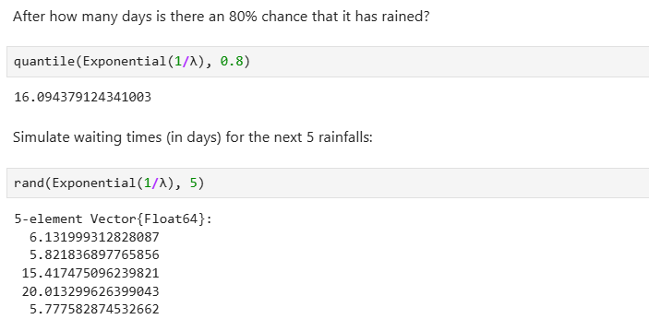
Probability Distributions in Julia
Exponential Distribution
Suppose that in a certain desert region, it rains once every 10 days on average. We want to analyse how long it will take until the next rain.

Slide 29
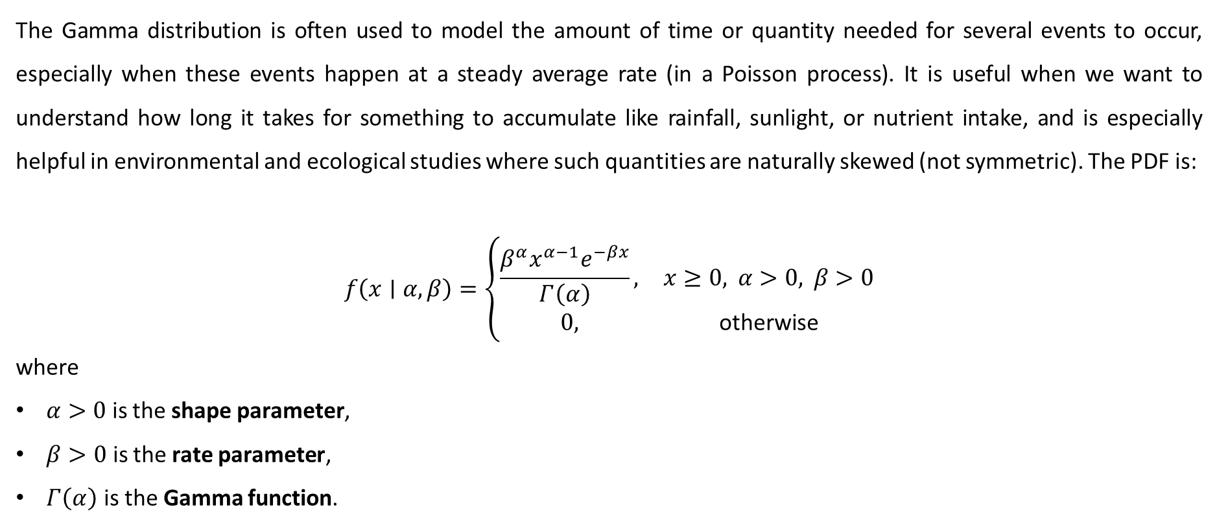
Probability Distributions in Julia
Gamma Distribution
The Gamma distribution is often used to model the amount of time or quantity needed for several events to occur, especially when these events happen at a steady average rate (in a Poisson process). It is useful when we want to understand how long it takes for something to accumulate like rainfall, sunlight, or nutrient intake, and is especially helpful in environmental and ecological studies where such quantities are naturally skewed (not symmetric). The PDF is:
$$f\left(x∣α,β\right)=\left\{\begin{matrix}\frac{β^{α}x^{α−1}e^{−βx}}{Γ\left(α\right)}, & x≥0, α>0, β>0 \\ 0, & \text{otherwise}\end{matrix}\right.$$
where
$α>0$ is the shape parameter,
$β>0$ is the rate parameter,
$Γ\left(α\right)$ is the Gamma function.

Slide 30
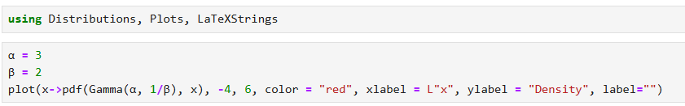
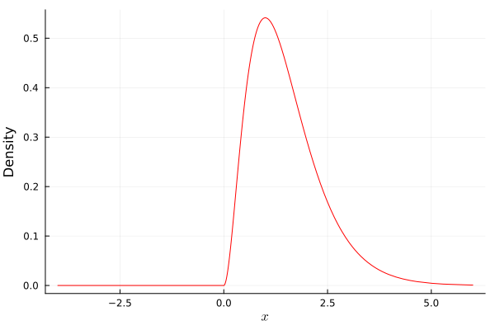
Probability Distributions in Julia
Gamma Distribution
Rate parameter
Shape parameter

Slide 31
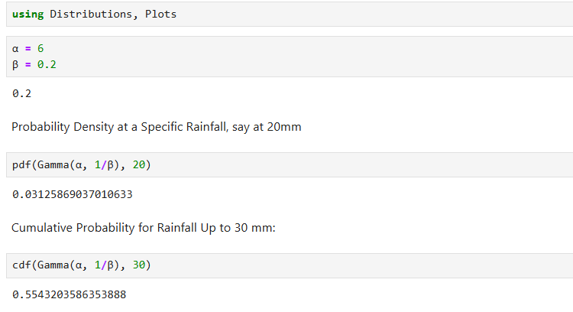
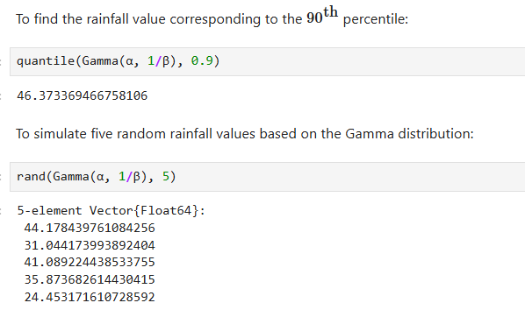
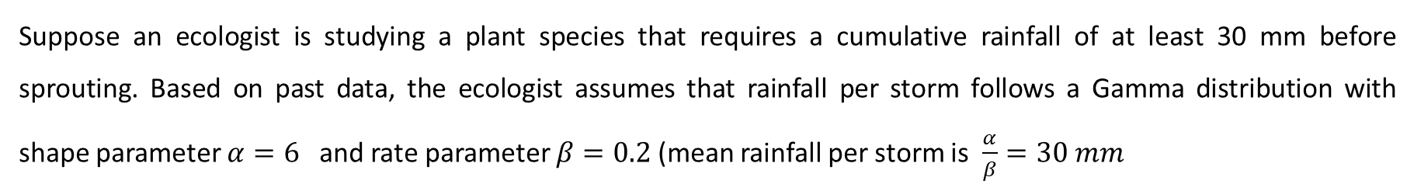
Probability Distributions in Julia
Gamma Distribution
Suppose an ecologist is studying a plant species that requires a cumulative rainfall of at least 30 mm before sprouting. Based on past data, the ecologist assumes that rainfall per storm follows a Gamma distribution with shape parameter $α=6$ and rate parameter $β=0.2$(mean rainfall per storm is $\frac{α}{β}=30 mm$

Slide 32
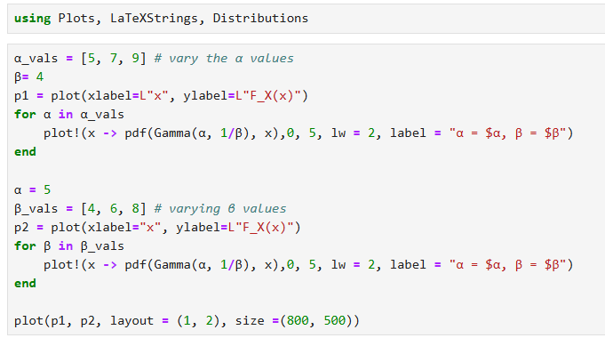
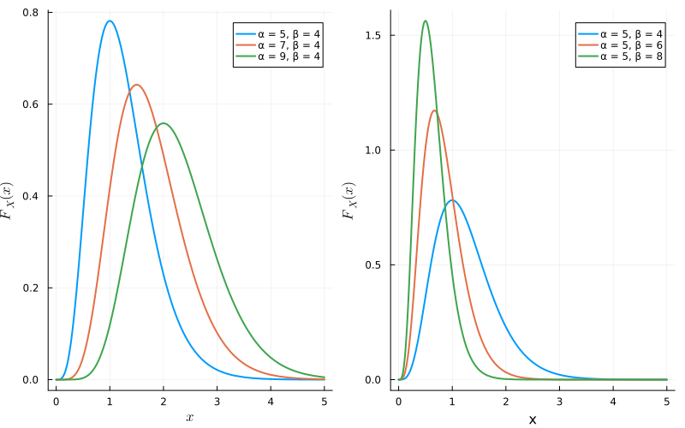
Probability Distributions in Julia
Gamma Distribution
The Gamma distribution exhibits notable changes in shape depending on the values of the shape parameter α and the rate parameter β. As 𝛼 increases, the distribution becomes more symmetric and its peak shifts to the right. In contrast, increasing 𝛽 leads to a steeper decline and greater concentration near zero, due to its inverse relationship with the scale.

Slide 33
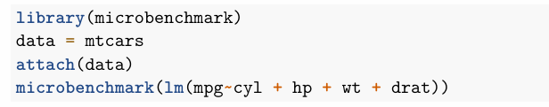

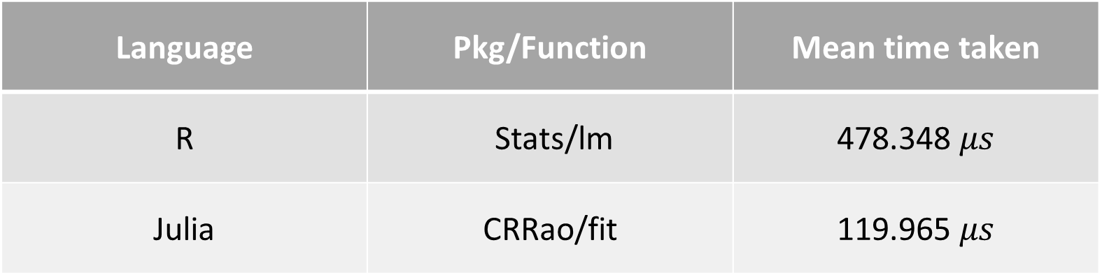
Comparison of Execution Time in R and Julia
To illustrate this, we consider an example of multiple linear regression.
R Code
Julia Code
Language | Pkg/Function | Mean time taken
R | Stats/lm | 478.348 $μs$
Julia | CRRao/fit | 119.965 $μs$

Slide 34
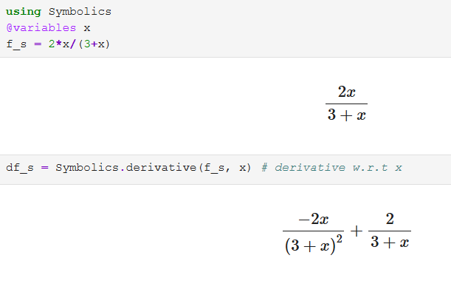
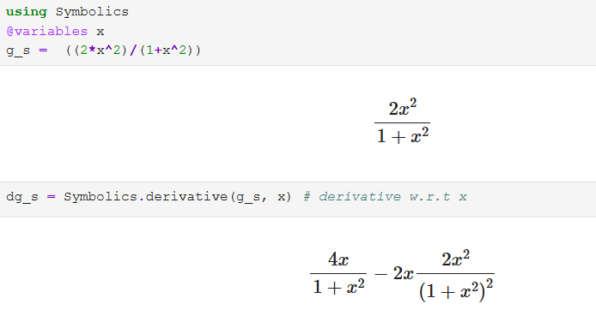
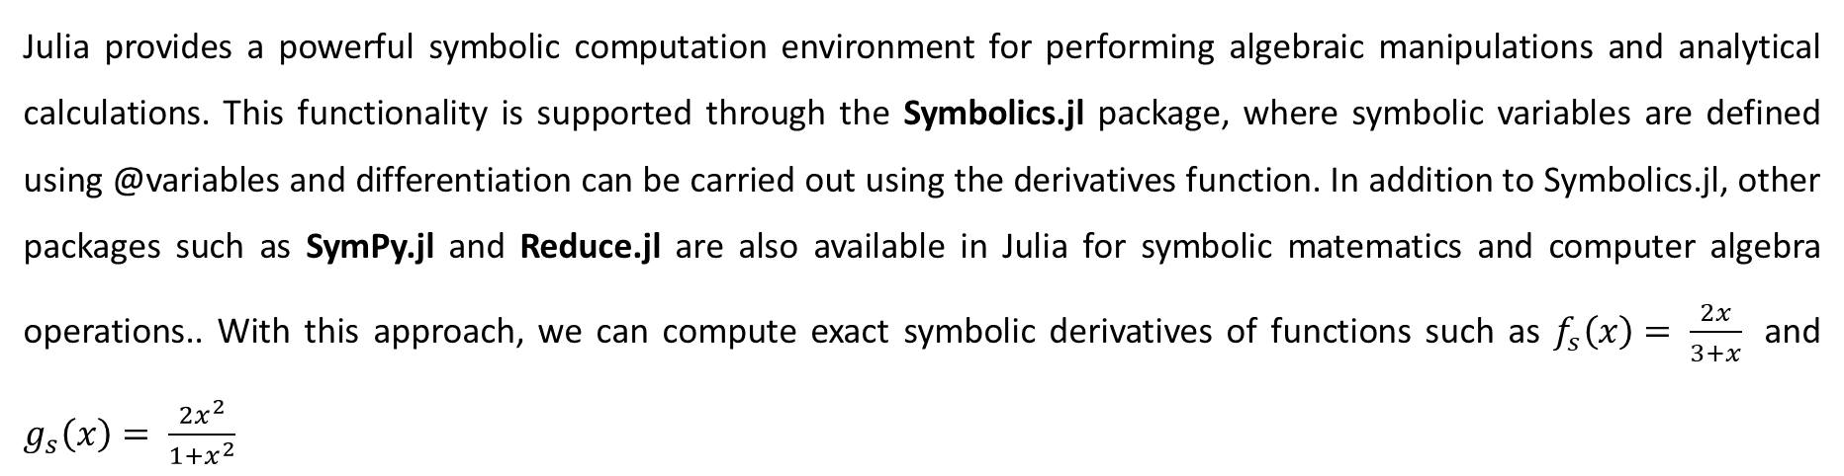
Symbolic Computation in Julia
Julia provides a powerful symbolic computation environment for performing algebraic manipulations and analytical calculations. This functionality is supported through the Symbolics.jl package, where symbolic variables are defined using @variables and differentiation can be carried out using the derivatives function. In addition to Symbolics.jl, other packages such as SymPy.jl and Reduce.jl are also available in Julia for symbolic matematics and computer algebra operations.. With this approach, we can compute exact symbolic derivatives of functions such as $f_{s}\left(x\right)= \frac{2x}{3+x}$ and $g_{s}\left(x\right)= \frac{2x^{2}}{1+x^{2}}$

Slide 35
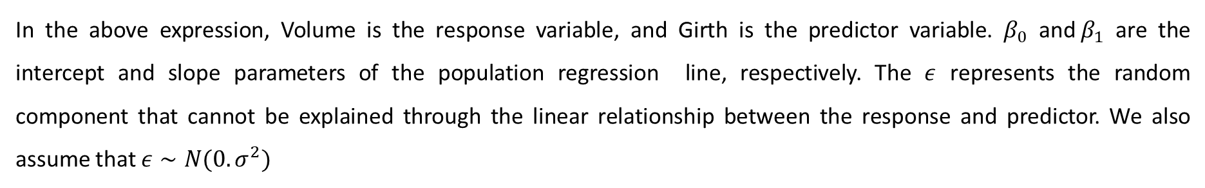

Simple Linear Regression
To demonstrate simple linear regression, we consider the trees dataset provided with R. In Julia, the same dataset can be imported using the RDatasets.jl package, enabling users to perform regression analysis in Julia using a dataset familiar from R. This dataset provides measurements of the diameter, height, and volume of timber in 31 felled black cherry trees. Note that the diameter (in inches) is erroneously labeled Girth in the data. Suppose we aim to predict the Volume of the timber using the tree diameter. Therefore, we consider the following statistical model
$$Volume=β_{0}+β_{1}Girth +ε$$
In the above expression, Volume is the response variable, and Girth is the predictor variable. $β_{0}$ and${ β}_{1}$ are the intercept and slope parameters of the population regression line, respectively. The $ε$ represents the random component that cannot be explained through the linear relationship between the response and predictor. We also assume that $ε∼N(0. σ^{2})$

Slide 36
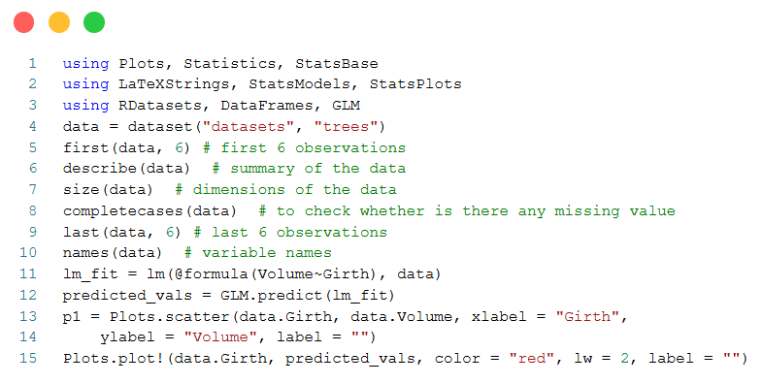


Simple Linear Regression

Slide 37
Conclusion
Julia has emerged as a powerful scientific computing language, effectively combining high-level expressiveness with performance comparable to low-level programming languages.
Its unified programming environment allows researchers to develop, test, and deploy computational models efficiently without switching between multiple languages.
Support for abstraction, metaprogramming, and a growing scientific ecosystem enables applications in simulation, optimization, machine learning, and data-intensive research.
Interoperability with Python, R, C, and Fortran ensures seamless integration with existing workflows and facilitates adoption within established scientific communities.
While standardized documentation remains limited, ongoing development and strong community support position Julia as a key platform for modern scientific computing, statistical computing & data science.

Slide 38
Acknowledgement
I express my sincere gratitude to Dr. Amiya Ranjan Bhowmick (Department of Mathematics, ICT Mumbai) for his invaluable mentorship and guidance. I consider myself truly fortunate to have been receiving his guidance for the past three years.
Special thanks to Dr. Ajit Kumar (Department of Mathematics, ICT Mumbai), Dr. Md Aktar UL Karim (Symbiosis Statistical Institute, Pune), Dr. Dipali Vasudev Mestry (Department of Mathematics, ICT Mumbai), and Dr. Dipak D. Pukale (University of Akron, USA) for their encouragement and motivation.

Slide 39
References:
Nagar, S., Nagar, & Anglin. (2017). Beginning Julia Programming. Springer Science+ Business Media.
Dash, S. K. (2021). Hands-On Julia Programming: An Authoritative Guide to the Production-Ready Systems in Julia (English Edition). BPB Publications.
McNicholas, P. D., & Tait, P. (2019). Data science with Julia. Chapman and Hall/CRC.
Phillips, L. (2023). Practical Julia: A Hands-on Introduction for Scientific Minds. No Starch Press
Chaugule, S. S., & Bhowmick, A. R. (2025). A gentle introduction to statistical computing using Julia (Version 2025). GitHub. https://github.com/sujit016/A-Gentle-Introduction-to-Statistical-Computing-Using-Julia
Verzani, J. (2025, August 29). Calculus with Julia. https://jverzani.github.io/CalculusWithJuliaNotes.jl/
Nazarathy, Y., & Klok, H. (2021). Statistics with Julia: Fundamentals for data science, machine learning and artificial intelligence. Springer Nature

Slide 40
Thank You

